Slide 1

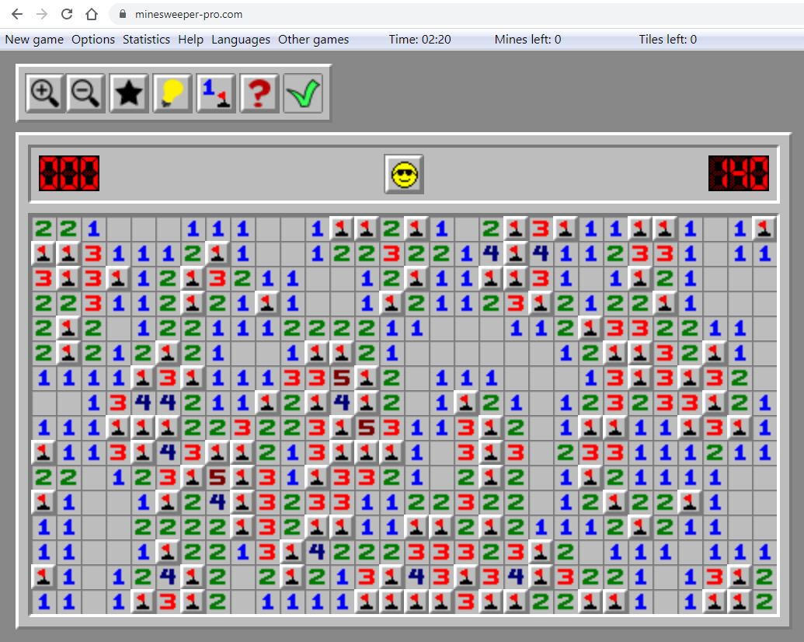
MineSweeper: An In-depth Look into Cryptojacking and Its Defense
CIS-447
FALL 2022
with Dr. Anys Bacha
Team 7: Paper Review
by
Endrit Zenuni, Demetrius Johnson,
Bhoomika Gowda Varadaraja, Sania Afreen
Notes:
Endrit

Slide 2


How many of you have been involved with Cryptocurrency?
Notes:
Endrit

Slide 3
Introduction
2017- year of Cryptocurrencies
Market Capitalization went from 15 billion USD to 800 billion USD
led to proliferation of cryptomining services - Coinhive (integrated into website to mine on its visitor’s devices from within the browser)
Cryptojacking
Notes:
Bhoomika

Slide 4
Introduction
Cryptojacking??
Cryptojacking/Drive-by Mining
web-based attack
infected website secretly executes JavaScript code and/or a WebAssembly module in the user’s browser to mine cryptocurrencies without consent
another party’s computing resources are hijacked to mine cryptocurrency
electricity, computation power
Notes:
Bhoomika

Slide 5
Introduction
Why is it not good?
No consent
Degrade system performance
Power consumption
Affect device lifespan
Notes:
Bhoomika
drains out battery

Slide 6
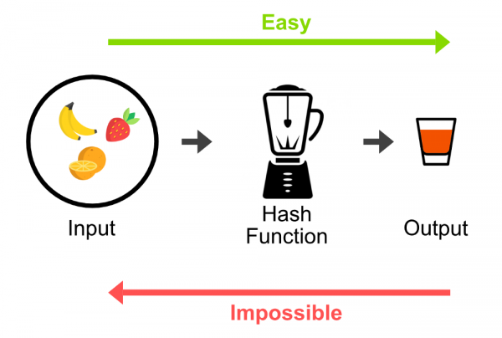
Quick review of Crypto Mining: hashing power
Hash algorithm:
1-way function (cannot take inverse to find original input),
each input should produce only 1 unique output (1:1)
each output is unique to all other outputs (no collisions or nearly impossible for outputs to collide).
Lossy Compression of data → large input yields small output.
Example: SHA - 256 bit hash algorithm takes any input and will output a 256-bit hash.
Notes:
Demetrius Johnson
special note: if SHA-256 was reversible, then we would have a very powerful lossless compression algorithm.
crypto mining is all about hashing.
you need brute force to find a particular hash output, since hash algorithm is irreversible.
brute force = primary limiting factor is computational power (most often time/computation; but space can also be limiting factor).
as you increase the number of consecutive 0s required for the first n bits of a hash, you increase the difficulty, but you also decrease the number of “blocks” that can be mined at that difficulty, since less bits are left over that can be changed.

Slide 7
Quick review of Crypto Mining: hashing power
Hash algorithm:
1-way function (cannot take inverse to find original input),
each input should produce only 1 unique output (1:1)
each output is unique to all other outputs (no collisions or nearly impossible for outputs to collide).
Lossy Compression of data → large input yields small output.
Example: SHA - 256 bit hash algorithm takes any input and will output a 256-bit hash.
Question 1: what are the chances that your input will produce an output where the first 10 bits in a 20-bit hash will all be 0s?
00000000001010001011
Question 2: based on the previous question, how many input scenarios (possibilities) can there be that will produce all 0s for the first 10 bits?
Notes:
Demetrius Johnson
special note: if SHA-256 was reversible, then we would have a very powerful lossless compression algorithm.
crypto mining is all about hashing.
you need brute force to find a particular hash output, since hash algorithm is irreversible.
brute force = primary limiting factor is computational power (most often time/computation; but space can also be limiting factor).
as you increase the number of consecutive 0s required for the first n bits of a hash, you increase the difficulty, but you also decrease the number of “blocks” that can be mined at that difficulty, since less bits are left over that can be changed.

Slide 8

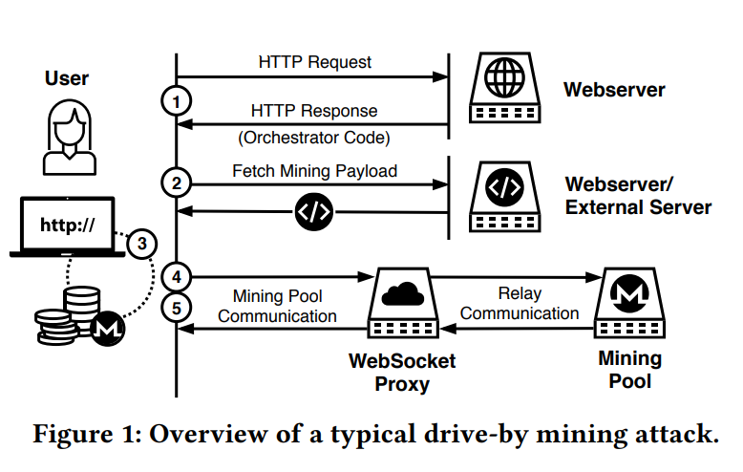
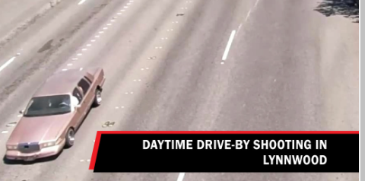

Drive-by Cryptojacking Setup
The communication between a cryptominer and the proxy server contains two interesting pieces of information:
the proxy server address
and the client identifier (also known as the site key)
cryptojacking in
Notes:
meech
the web/external server is what would usually be the Advertisement server, but instead it is the server that has the mining payload (the code that will be sent to client so that mining can be executed in the client’s browser).
client identifier (aka site key) is the website used to host the mining service so that the website owner can get their cut/share of profit from the mining.
Figure 1 illustrates a typical drive-by mining attack. A cryptocurrency mining script contains two components: the orchestrator and the mining payload. When a user visits a drive-by mining website, the website
(1) serves the orchestrator script, which checks the host environment to find out how many CPU cores are available,
(2) downloads the highly-optimized cryptomining payload (as either Wasm or asm.js) from the website or an external server,
(3) instantiates a number of web workers [70], i.e., spawns separate threads, with the mining payload, depending on how many CPU cores are available,
(4) sets up the connection with the mining pool server through a WebSocket proxy server, and,
(5) finally, fetches work from the mining pool and submits the hashes to the mining pool through the WebSocket proxy server. The protocol used for this communication with the mining pool is usually Stratum
we identified 159 different WebSocket proxy servers being used by the 1,735 drive-by mining websites and only six of them are sending the public mining pool server address and the cryptocurrency wallet address (used by the pool administrator to reward the miner) associated with the website to the proxy server.
4.3.7 Profit Estimation. All of the 1,735 drive-by mining websites in our dataset mine the CryptoNight-based Monero (XMR) cryptocurrency using mining pools. Almost all of them (1,729) use a site key and a WebSocket proxy server to connect to the mining pool; hence, we cannot determine their profit based on their wallet address and public mining pools.

Slide 9
Existing defenses against this problem
Blacklisting mining pools, proxy servers, URLs
X obfuscation and URL randomization
CPU usage Heuristics
X CPU throttling
Notes:
Bhoomika
How it can be defeated?
CPU Throttling
URL randomization

Slide 10
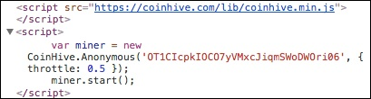
Existing defenses against this problem
Notes:
Bhoomika
client-ID, change the throttle value to assign the CPU usage
No incentive for Coinhive to stop providing services since it keeps 30% of what is mined, and then 100% after site-key’s are terminated but people still keep mining away, IT IS SUPER EASY TO IMPLEMENT IN ANY WEBSITE

Slide 11
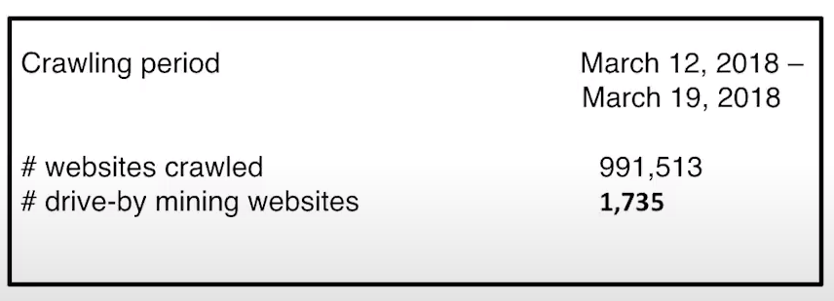
Data Collection
Used a crawler scanning Alexa’s top 1 million websites.
Looked into 3 internal pages on each site and made certain that the crawler agent did not give any consent to use resources.
From above:~ 0.002% of the sites crawled contained (detected/identified) drive-by cryptojacking code.
Notes:
meech
notice this was in 2018, imagine if they did this same analysis today? or with more websites?

Slide 12
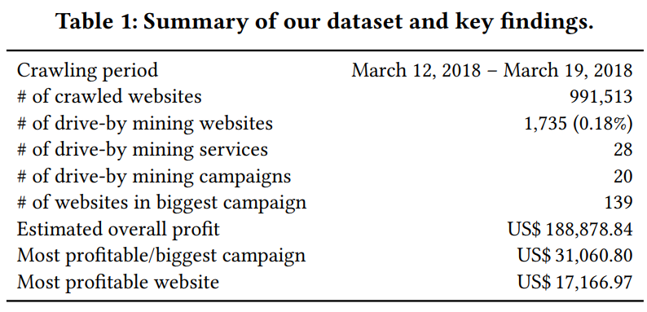
Data Analysis Results
Notes:
meech
notice, many of the 1,735 drive by mining websites used the same mining service.
notice several mining services may be a part of 1 campaign.

Slide 13
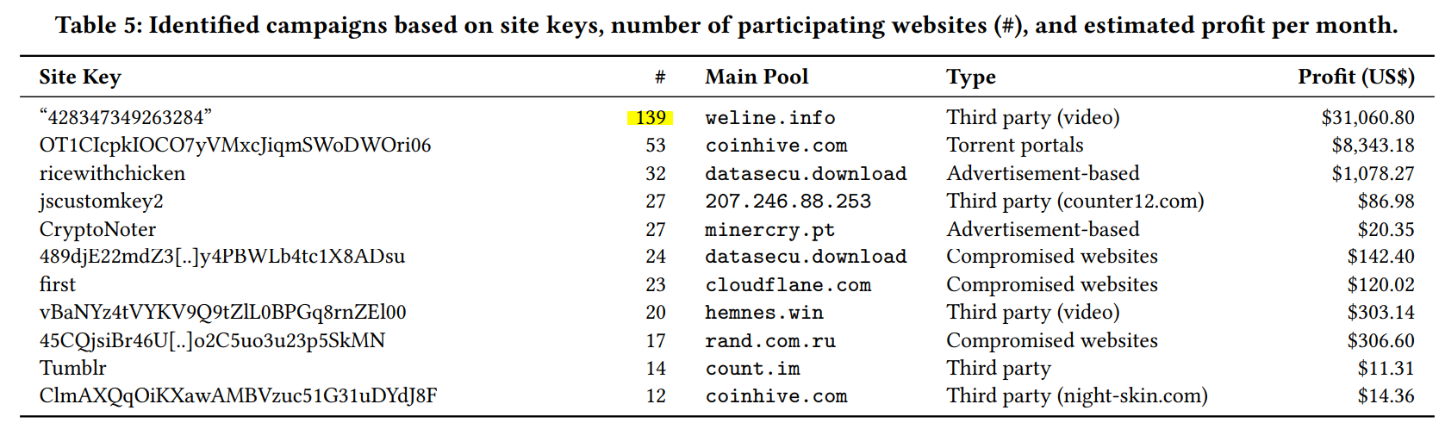
Data Analysis Results - drive-by cryptojacking campaigns identified (by site keys)
Note: these are estimated profit values of only a sample (from 1 million sites crawled) of websites;
Notes:
meech
in the above graphic, the first row has site key shown (associated with the crypto mining client), and it was embedded in a media player; 139 sites (as shown) had this same media player which included code for mining using the browser of the connected client.
ever wonder why those “free movie” sites run so slow or has so many ads? or suddenly not so many ads (because traded out for crypto jacking).

Slide 14
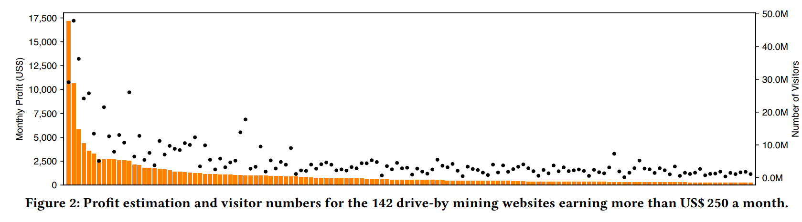
Data Analysis Results - profit estimation using SimilarWeb to gather profit statistics
Orange bars = # of visitors Black dots = month profit
Notes:
meech
graphic showing only the top 142 earners out of all sites identified to be doing crypto jacking.
we identified 159 different WebSocket proxy servers being used by the 1,735 drive-by mining websites and only six of them are sending the public mining pool server address and the cryptocurrency wallet address (used by the pool administrator to reward the miner) associated with the website to the proxy server.
4.3.7 Profit Estimation. All of the 1,735 drive-by mining websites in our dataset mine the CryptoNight-based Monero (XMR) cryptocurrency using mining pools. Almost all of them (1,729) use a site key and a WebSocket proxy server to connect to the mining pool; hence, we cannot determine their profit based on their wallet address and public mining pools.

Slide 15
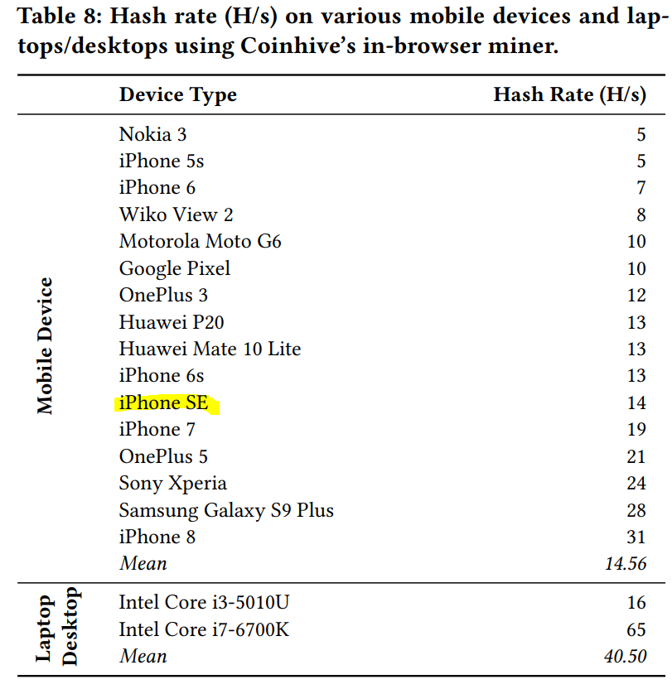
Hashing Power
Notes:
meech
notice how intense hashing is; even powerful phones like Iphone 8 can only support 14 hashes/second

Slide 16
Introducing MineSweeper
In summary targets the more fundamental properties of mining code that is near impossible or VERY painful for miners to remove.
The idea is that the only way to bypass the detector is to cripple the algorithm.
What’s it do?
It takes the URL of the website as input and employs three different approaches for detection of Wasm-based miners.
Notes:
Endrit

Slide 17
Detection using minesweeper
Two of these methods statically analyse the Wasm module used by the website
For miners with mild variations of obfuscations of CryptoNight
(checks for 5 cryptographic primitives, which are all necessary for hash correctness. and minesweeper only needs to find one through fingerprinting)
Detecting cryptographic functions in a generic way
Checks whether the number of XOR, shift, and rotate operations inside loops or functions that exceed a certain threshold
Notes:
Endrit (checks for 5 cryptographic primitives, which are all necessary for hash correctness. and minesweeper only needs to find one, so pretty much fingerprinting) NEEDS TO ALL TO BE CORRECT and if minesweeper finds one then were good
Checks number of XOR, shifts, and rotate operations inside loops or functions if it exceeds a certain threshold

Slide 18
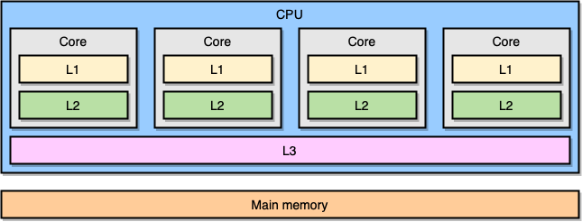
Detection using minesweeper
Relies on CPU cache events
For more heavily obfuscated code (checks for higher load/store execution frequency relative to other cases by checking L1 and L3 Caches)
Future-proofing (performance crippled code)
in case miners start trying to sacrifice profits for evasion
Notes:
Endrit

Slide 19
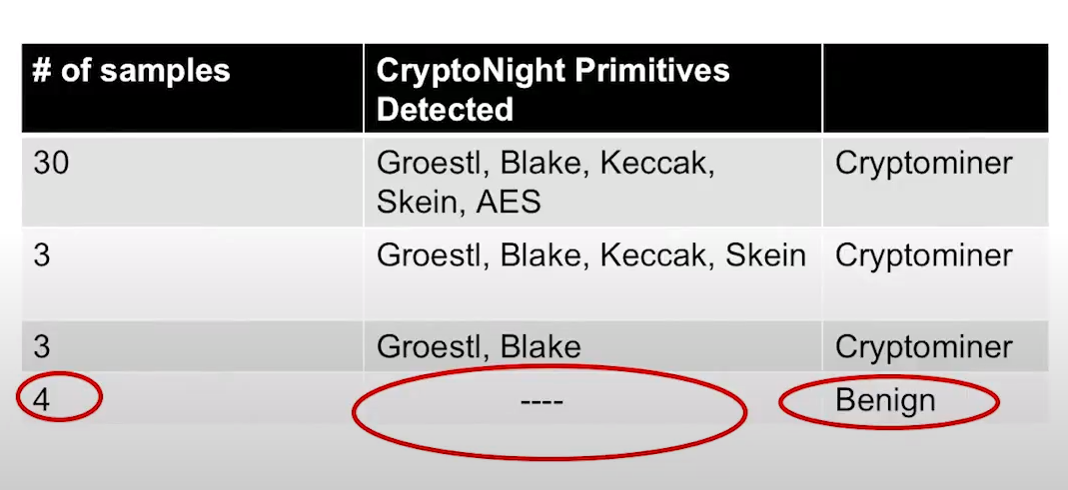
MineSweeper Evaluation
Fingerprinting
From 748 WASM samples from 1 million pages:
Only 40 unique samples
Not many variants of CryptoNight implementation(a lot of reuse)
4 were still benign when using fingerprinting method
Notes:
Sania
BUT there were 4 samples that were benign that were not able to be found using the fingerprinting technique

Slide 20
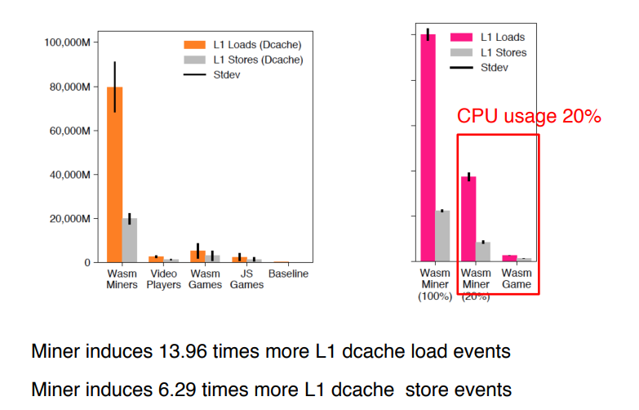
What about obfuscation?
Solution: monitor the number of loads and stores that a program calls.
Notes:
Sania
Above table shows that most Cryptominer programs use the same codebase logic of only about 40 unique mining programs.
makes sense because Web Assembly performance plus newer cryptos (unlike Bitcoin) use hash algorithms developed to allow optimized hashing on modern CPUs and their usual 2MB cache.

Slide 21
Limitations?
Notes:
Bhoomika

Slide 22
Limitations
only crawled 1 million websites and from one source (Alexa)
- good sample size, but not diverse
only navigated 3 internal pages per site
- more navigation –->reveal greater number of drive-by mining websites
spend 4 seconds on each website
- could have missed websites that wait before before serving mining payload
visit each webpage only once
- cryptomining payloads that spread through advertisement networks are not served on every visit
crawlers did not capture the cases where cryptominers are loaded as ‘pop under’ windows
crawlers may have defects and cause data collection for analysis to be misleading
- rigorous human interaction or assistance along side crawler during analysis on each site would yield possibly more trustworthy data
Notes:
Bhoomika
What is the Difference between Minesweeper and x
MineSweeper exploits the core properties of CryptoNight to detect drive-by mining websites
*agent may not have visited the most visited internal page where the mining script would be sent
- Profit motivation for websites was merely estimated (could not get real profit values because of proxy server storing the wallets instead of the mining pool).
for example: if wallet stored on mining pool, you could just join the pool and view the pool’s wallet.
Cryptojacking identification methods could potentially be severely lacking and cause the data to be overlooked or misinterpreted - a better identification method may help detect more drive-by mining and identify with more granularity the types of services used (and the number of them and their associations with campaigns).

Slide 23
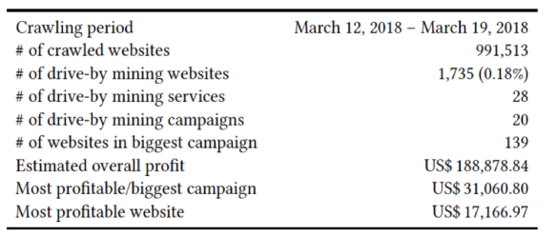
Conclusion
Drive-by Cryptojacking is becoming increasingly popular.
CryptoNight is a newer technique used by newer crypto currency to implement hashing algorithms that takes advantage of modern CPUs
this allows for cryptojackers to evade standard cryptomining detection algorithms.
Minesweeper uses new techniques (such as load/store, XOR, rotation,etc.) to detect Cryptojacking software of the newer cryptoming standards.
Notes:
Sania
*notice they can make up to 0.2%

Slide 24
Questions?

Slide 25
References
Link to paper: https://dl.acm.org/doi/pdf/10.1145/3243734.3243858
Link to video presentation by the author: https://www.youtube.com/watch?v=fnyipz-2D0E

